Slide 1
Farm Management Consulting
Farm Management Consulting
MNP Canadian Agriculture Industry Outlook Fall 2021
Presented by: John Loeppky P.Ag
Date: November 2021

Slide 2
Ag Industry Outlook – Table of Contents
Canadian Agricultural Industry Outlook 2020
Market Fundamentals
US Dollar – US Trade
Poultry
Dairy
Crops
Hogs
Beef
Wineries
Cannabis
Food and Beverage
Contacts
Appendices
Our People

Slide 3
Industry Outlook 2021
The Market Fundamentals
Supply - Demand
Trade
Supply Chain Disruptions
Supply Management
Notes:
Trade

Slide 4
Industry Outlook 2021
Source: Bank of Canada

Slide 5
Industry Outlook 2021
Canada and China
Huawei CFO Meng Wanzhou returned to China last month as part of a deal with the US prosecutors
She had been detained on house-arrest in her Vancouver home since December of 2018
Days following her departure, the two Canadian citizens charged for espionage were on their way back to Canada
Tension still remains between the two countries, as Canada is unsure about its position on China’s request to join the Comprehensive and Progressive Agreement on Trans-Pacific Partnership (CPTPP)
The CPTTP is one of the worlds largest free trade areas
China’s economic size is larger than all the 11 members combined

Slide 6
Industry Outlook 2021
Fertilizer Plant Closures
Multiple fertilizer manufacturing plants in the UK have ceased production due to extremely high natural gas prices
Wind generated energy production was weaker than expected, causing many regions to rely on natural gas
As a result, fertilizer prices around the world have hit highs not seen since 2008
Producers across multiple industries are feeling the financial pressure, as gross margins are anticipated to be tighter in the coming year

Slide 7
Industry Outlook 2021
Global Freight
Freight shortages continue to disrupt supply chains of key commodities and industries
Import terminals are seeing increased traffic, and shipping container availability is extremely low
Cargo ships have waited weeks to dock at terminals
With commodity prices already near all-time highs, freight disruption adds uncertainty to an already tight supply outlook
Item availability is at risk with economies in full swing, especially approaching the holiday season

Slide 8
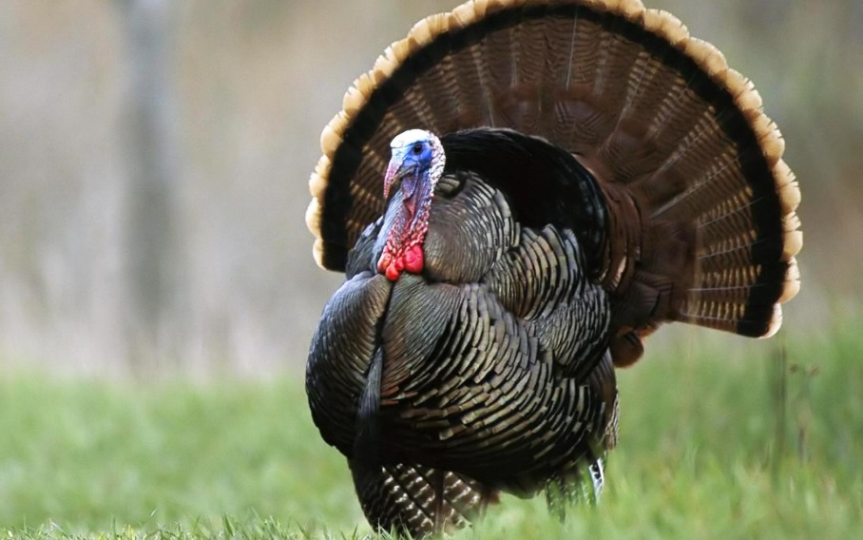
Industry Outlook 2021
Poultry
Outlook for growth in 2022
Profitability a mix of improving prices/consumption and rising feed costs
Trade Deal Compensation
Safe Guards
Understand the quota:
Provincial legislation re: transferability.
Debtor’s utilization and options to lease out quota.
Understanding compensation rules will have bearing on security.
High land values may support security position

Slide 9
Industry Outlook 2021
Demand has recovered over the last 2 quarters
Renewed restaurant traffic has been a main driver
Demand and Supply stabilization is expected in Q4
Chicken wing prices are extremely high, but have remained flat over Q3
Chicken remains the #1 meat consumed in Canada

Slide 10
Industry Outlook 2021
Poultry and Egg On-Farm Investment Program
Intent is to compensate farmers for market share given up during CPTPP trade deal and boost competitiveness
$647 million over ten years for chicken, turkey, egg and broiler hatching egg
Eligible projects include:
increasing efficiency/productivity
responding to consumer preferences
improving on farm safety, biosecurity or environmental sustainability

Slide 11
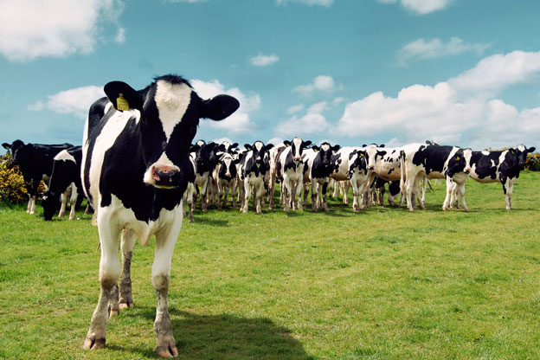
Industry Outlook 2021
Dairy
Consumer demand shifting
Rising feed costs
Support price increasing
Safe Guards
Understand the quota:
Provincial legislation re: transferability.
Debtor’s utilization and options to lease out quota.
Understanding compensation rules will have bearing on security.
High land values may support security position

Slide 12
Industry Outlook 2021
Source: Dairy Farmers of Manitoba

Slide 13
Industry Outlook 2021
Feed costs continuing to rise.
Purchased feed cost driven by high commodity prices
Homegrown feed cost driven by high fertilizer, fuel, labour costs
Currently the price increases are not keeping up with cost increases, so margins are being compressed.
Milk price increases are based on the following:
50% annual cost of production study
50% consumer pricing index (from Statistics Canada)
Notes:
$1.39/HL is due to feed price increase from 2019 to 2020

Slide 14
Industry Outlook 2021
2019
COP was $83.13/hL
CPI was -$1.51/hL
Support price was $81.62/hL
2020
COP was $85.42/hL
CPI was $6.78/hL
Support price expected to be $92.20/hL
Notes:
$1.39/HL is due to feed price increase from 2019 to 2020

Slide 15
Dairy Production
Quota Exchange Value - $/Kg purchased
Sept. 2019 $28,000/kg
Sept. 2020 $32,100/kg
Sept. 2021 $37,250/kg

Slide 16
Industry Outlook 2021
Crops
2021 Harvest
Farm Equipment
Safe Guards
Equipment ratio on grain farms is important.
Ensure all property of creditor included on debt security
Verify proper registration on land and related farm equipment
Verify crop insurance & AgriStability status

Slide 17
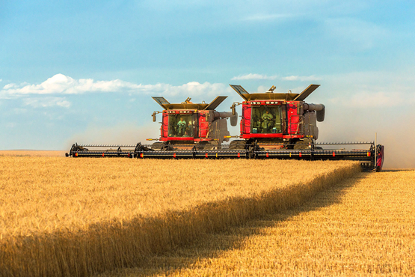
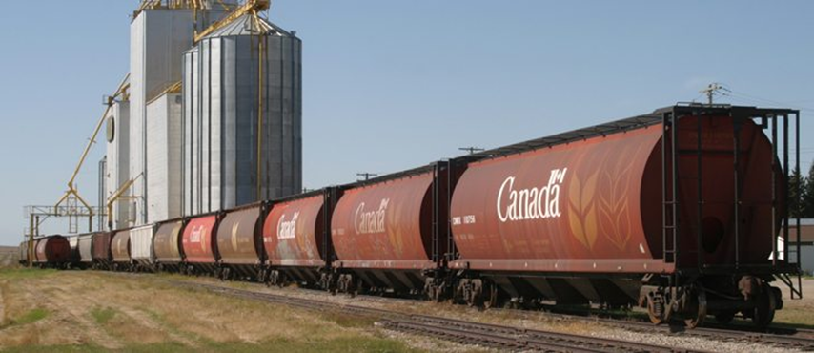
Industry Outlook 2021
Grain Production – USA
Harvest ahead of 5-year avg
Back-to-back big crops
Corn: 14.2 billion bushels – 2020
Forecasted at 15.02 billion bushels -2021
Soybeans: 4.268 billion bushels – 2020
Forecasted 4.4 billion bushels - 2021
Record yield increase

Slide 18
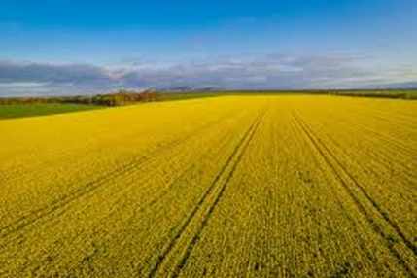
Industry Outlook 2021
Grain Production - Canada
Majority of grain producing areas had good harvest weather
Harvest was mostly uneventful in Western Canada
Struggling in Ontario due to heavy rains
Grain movement has been good
Yields are down from Western drought conditions
Eastern corn and winter wheat are up
Western Canada harvest progress ahead of 5-yr avg
AB – 96% complete as of October 5th, 2021
SK – 99% complete as of October 5th, 2021
MB – 95% complete as of October 5th, 2021

Slide 19
Industry Outlook 2021
Grain Production - Canada
Stat’s Can estimates (as of Sep 14th, final report in Dec. 2021):
Smaller soybean production – 5.89 million tonnes
23.8% decrease from peak in 2017
5% increase in seeded acres, but 12% decrease in yield vs 2020
Smallest canola production in 5 yrs – 12.78 million tonnes
40.5% decrease from peak in 2017, 34.5% decrease from 2020
39.5% decrease in yield, 8.1% increase of seeded acres vs 2020
Lowest wheat production in 5 yrs – 21.71 million tonnes
29.3% decrease from 2020
Spring wheat production down 41% from 2020

Slide 20
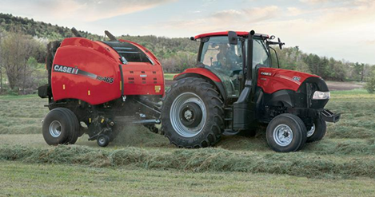
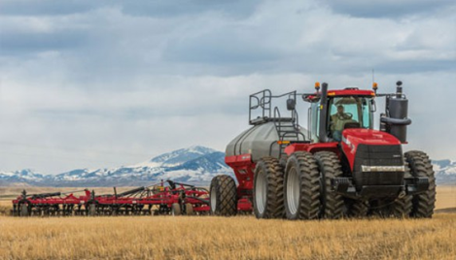
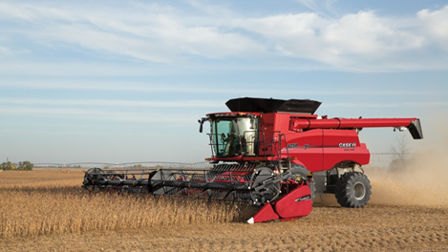
Industry Outlook 2021
Higher machinery purchases
2WD farm tractors up 12% YTD
4WD farm tractors up 30.3% YTD
Combine sales up 17.3% YTD
Source:Association of Equipment Manufacturers

Slide 21
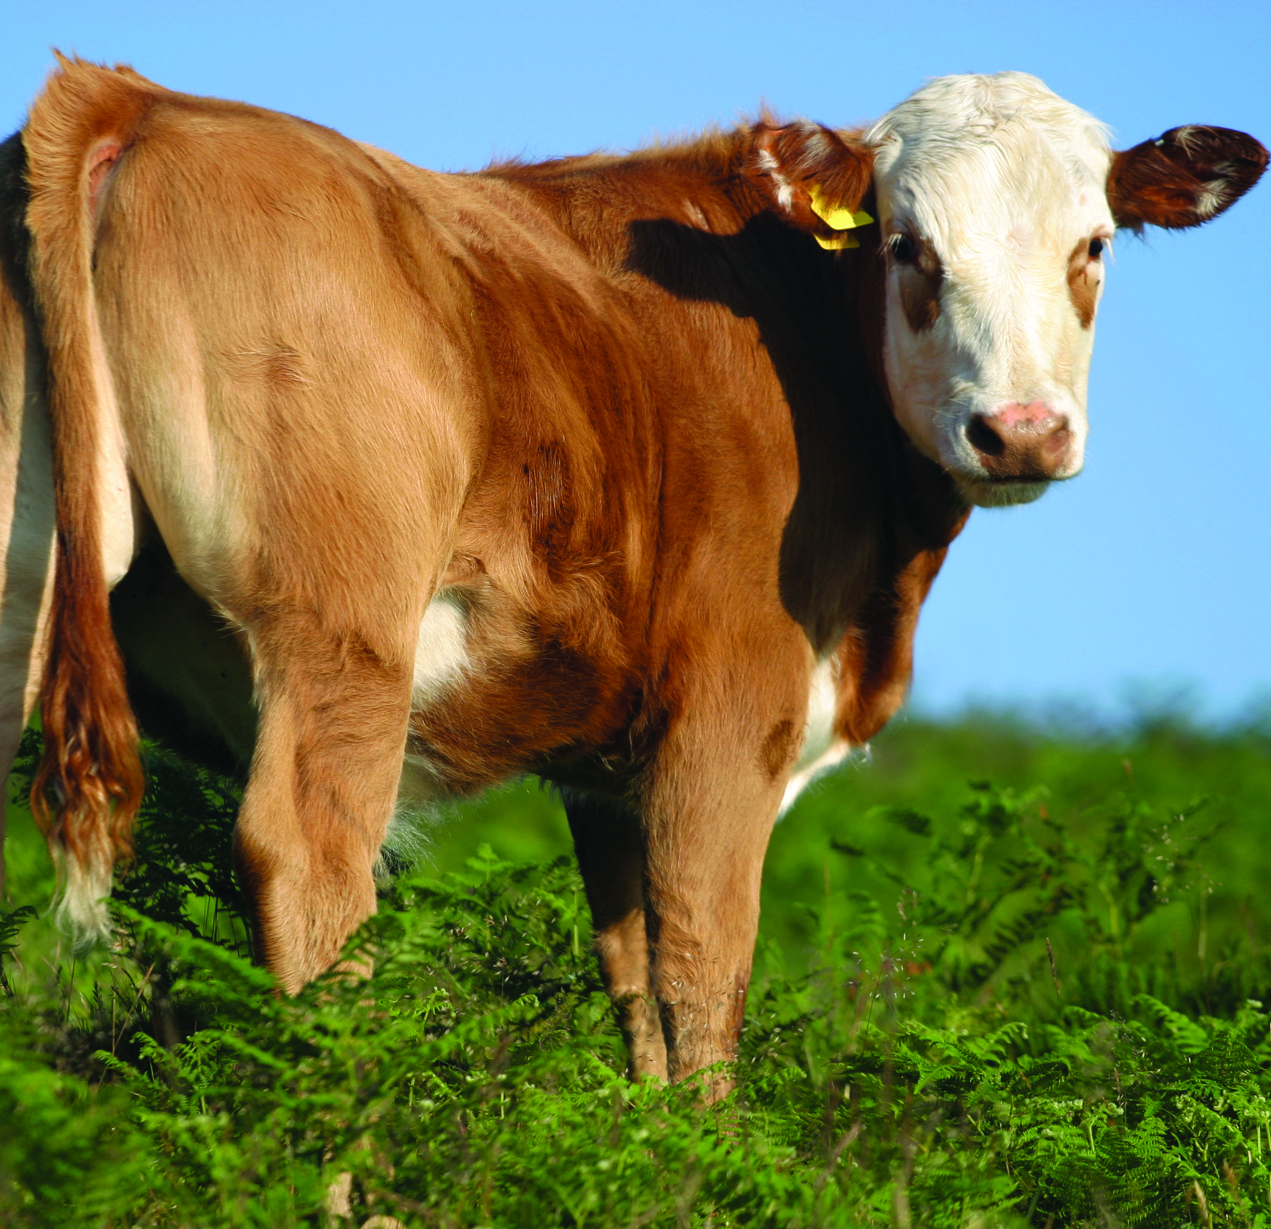
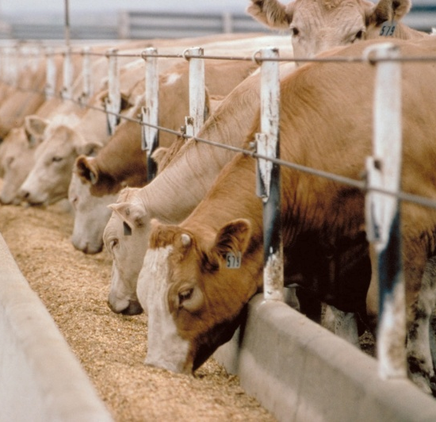
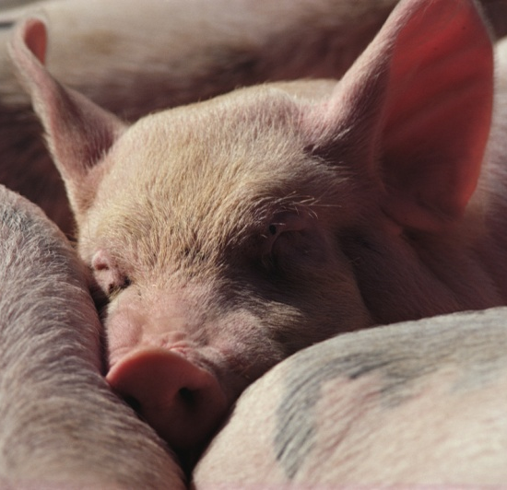
Industry Outlook 2021
Hogs
Positive margins this year
Strong prices being compressed by very high feed costs and strong Cdn dollar
ASF resurgence closer to home
New mutant strains harder to detect
Safe Guards
Perform walk-through on short notice and assess condition of
herd and barn operations
Verify proper registration on land and related farm equipment
Verify AgriStability status.

Slide 22
Hog Production – U.S.
U.S. slaughter capacity
2018 – 498,135 head per day
2020 – 506,470 head per day
April 29 – 267,367 (53%)
Smithfield Sioux Falls, SD
JBS Worthington, MN
Closures caused large backlog

Slide 23
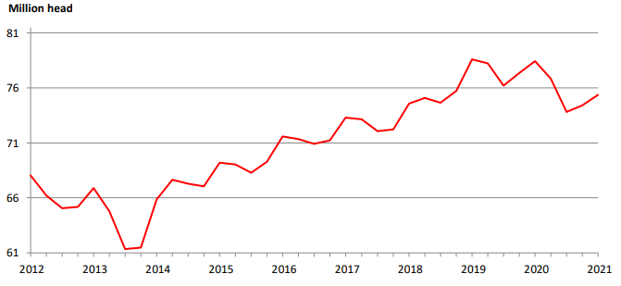
Hog Production – U.S.
U.S Hog Inventory 75.4 million head - Sept 2021
4% decrease from Sept 2020
1% increase from June 2021

Slide 24
Industry Outlook 2021
African Swine Fever
AFS has been identified in the Dominican Republic and Haiti
This could potentially cause major disruption in the North American market if this outbreak were to spread to Puerto Rico, which is a US territory
The USDA and US customs are taking precautionary measures already, in case the virus were to spread.
The main focus is to prevent the spread to the mainland US

Slide 25
Industry Outlook 2021
Cow/Calf
Drought in western provinces
Caused some herd dispersals
Earlier than usual fall calf run (July/August)
Gov’t support program (AgriRecovery) to assist with feed issues
Safe Guards
Perform walk-through on short notice
Verify inventory and require manifests and/or proof of purchase or sale. Look closely at inventory values.
Verify AgriStability and risk management practices.

Slide 26
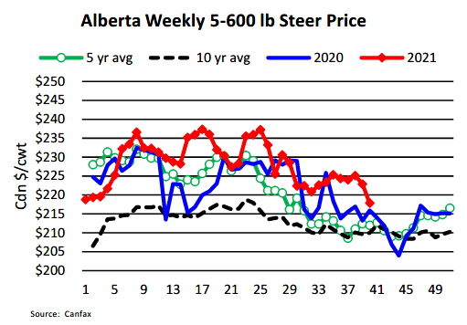
Industry Outlook 2021

Slide 27
Industry Outlook 2021
Feedlots
Canada switching from a net exporter to importer of cattle
Potential Cargill plant closure in High River, AB
Strike notice given
Represents 40% of CDN packing capacity
Feed prices pressuring margins
Safe Guards
Verify inventory and require manifests and/or proof of
purchase or sale
Verify AgriStability status and CPIP contracts
Ensure lands properly captured in loan documents and
registered at land titles
Check risk management practices. Scrutinise business plans.

Slide 28
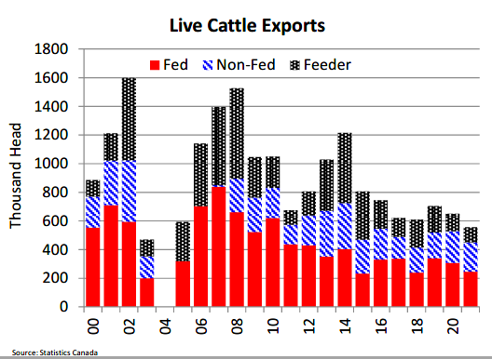
Industry Outlook 2021

Slide 29
Industry Outlook 2021
Wineries
Supply chain issues
Causing delays in shipping and increasing cost of goods
Likely will lead to higher inventory stocks and potentially higher lending needs
Mixed year for BC operations
Fire and heat reduced yield by 15-30% but higher quality
Safe Guards
Verify Inventory (and value in-use).- sample to ensure quality.
Confirm terms of licences to produce and sell are being met.
Seek rolling 5 year plans/third-party input – primary downfall is cash and
inventory management.

Slide 30
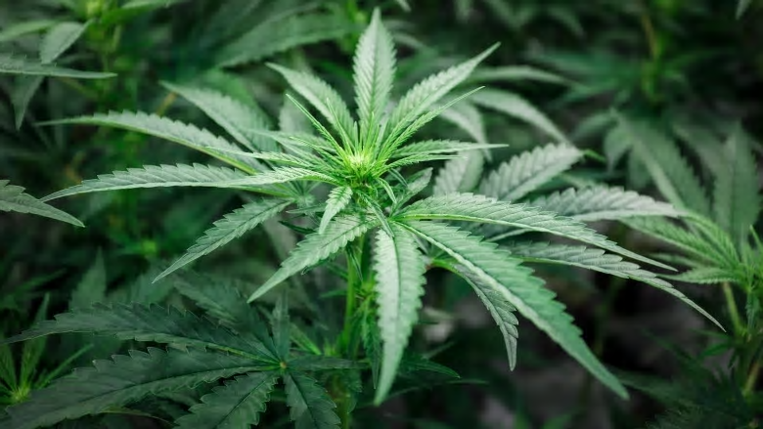
Industry Outlook 2021
Cannabis
Retail sales continue to increase
Changing price point
Continued mergers and acquisitions of major firms
Market share still seen to be fragmented even after M&A
Continued drive for lower cost of production
Safe Guards
Ensure all property of creditor included on debt security.
Confirm terms of licences to produce and sell are being met.
Confirm key individuals named in licences are tied to the company.

Slide 31
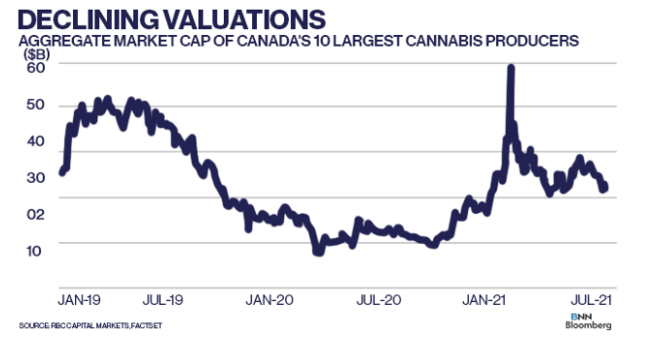
Industry Outlook 2021

Slide 32
Industry Outlook 2021
Food and Beverage
Margins getting tighter due to higher commodity and material prices.
Labour shortages continue
Demand is shifting back to foodservice and away from grocery as restrictions ease
Safe Guards
Ensure all property of creditor included on debt security.
Confirm terms of licences to produce and sell are being met.
Confirm key individuals named in licences are tied to the company.

Slide 33
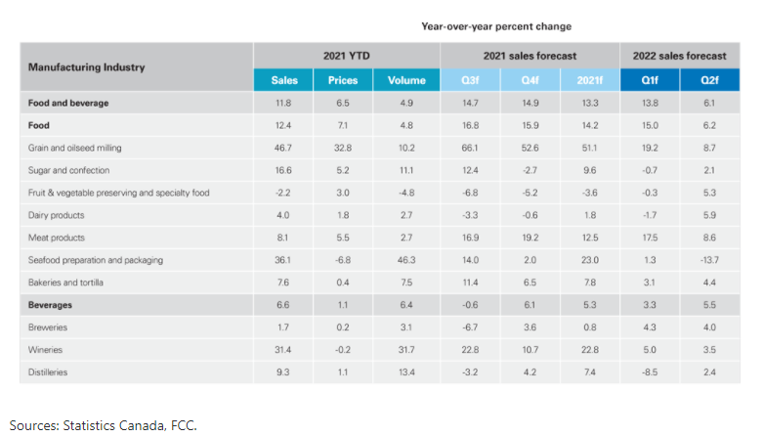
Industry Outlook 2021

Slide 34
Contacts
Farm Management Consulting
John Loeppky , P. Ag
Direct: 204.336.6148 Cell: 204.381.3260
john.loeppky@mnp.ca
Corporate Recovery Services
Victor Kroeger, CPA,CA,LIT,CIRP, CFE
Direct: 403.298.8479 Cell: 403.870.1827
vic.kroeger@mnp.ca

Slide 35
Appendices – Our People
The MNP Advantage:
Offices in strategic urban and rural locations from coast-to-coast
Experience with 18,000 commercial and 300 Hutterite Colony farm clients
Over 60 years service to agriculture has given us unparalleled and unrivalled access to the industry from the producer level all the way up to industry associations and government.
Nobody does it better.

Slide 36
Appendices – Our People
“Think Global, Act Local”
Over 85 offices from coast-to-coast.
Member of Praxity Global Alliance of Independent Firms giving us worldwide presence
The only professional accounting firm with a dedicated Farm Management Consulting group
We have specialists located in the areas necessary to meet the needs of our agricultural clients

Slide 37
Appendices – Our People
Over 600 professionals focused on the agriculture industry with niche specialities in:
Farm Management
Crops
Livestock
Farm income stabilization programs
AgriStability and AgriInvest
Agriculture specific accounting & tax
Food & Ag Processing
Hutterite Colonies

Slide 38
Appendices – Our People
Farm Programs
Farm Programs are a complex and highly specialised service-line.
With several hundred file preparers preparing over 9,000 applications a year backed up by 100 internally certified specialists MNP is the only firm in Canada to:
Take a full-service approach to Farm Programs.
Develop a specialised team to maximise program-revenue for our clients.
Prepare such a large volume of applications.

Slide 39
Appendices – Our People
Farm Programs
A Full-Service approach means that MNP does more than just complete the forms – we know what and how much we are applying for which means:
We know when payments are wrong and when it is worth following up and/or appealing.
We get what we claim 90% of the time.
We have a robust track record of reviewing non-MNP prepared applications and collecting under-claimed amounts.
Only firm in Canada with ability to analyse interaction between risk management programs enabling them to be truly used for risk management with our ARMP tool.

Slide 40
Appendices – Our People
The 25 professionals in MNP’s Farm Management Consulting group bring to bear a combination of on-the-farm experience and formal education
Education and experience include:
Bachelors of Science in Agriculture (B. Sc.)
Professional Agrologists (P. Ag)
Certified Agricultural Consultants (CAC)
Former and current farm managers and producers

Slide 41
Appendices – Our People
Within the Farm Management Consulting team we have niche professionals in:
Crop production and marketing (dryland and irrigated)
Intensive livestock production and marketing
Supply managed (dairy and poultry)
Commodity and food processing
Exotics
Greenhouse and Market Gardening
Orchard Fruit

Slide 42
Appendices – Special Situations
Working closely with Corporate Recovery Services, the Farm Management Consulting team have assisted with the provision of:
Initial assessment of a debtor
Monitoring
Restructuring
Liquidation

Slide 43
Appendices – Special Situations
The Farm Management Consulting team has provided the following services to Corporate Recovery Engagements:
Assisting with taking possession of farm operations
Determining and executing strategies for ongoing operations
Providing executive management of day-to-day farm operations
Consulting on key decision points in farm operations
Preparation of risk analysis and mitigation strategies
Providing input into realization plans

